Slide 1


Silhouette – Identifying YouTube Video Flows from Encrypted Traffic
Feng Li, Jae Chung, and Mark Claypool
Verizon Labs and Worcester Polytechnic Institute (WPI)
June 2018
Notes:
Default cover design.

Slide 2
Network Traffic Analysis
ניתוח תעבורת הרשת נעשה בעיקר כדי לקבל תובנה מעמיקה לתוך איזה סוג של תעבורת רשת או נתונים זורם דרך הרשת.
.
למה זה טוב לנו?
Notes:
Default cover design.

Slide 3
Network Traffic Analysis
הבנה והערכת נצילות הרשת
מהירות הורדה והעלאה
מקור, יעד, גודל ותוכן הפקטות
משמש בכל התחומים – הגנת רשתות, תקיפה, פרסום ועוד
Notes:
Default cover design.

Slide 4

DPI –deep packet inspection
Easy to spoof
Ineffective with encryption
Ineffective when source unknown
SNI- server name indication
מאפשר לנו לדעת איזה סוג תוכן מוזרם על ידי השרת שממנו
נשאב המידע. (דוגמה בסוף ההרצאה)

Slide 5
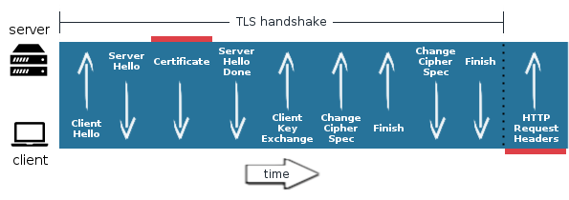

Slide 6
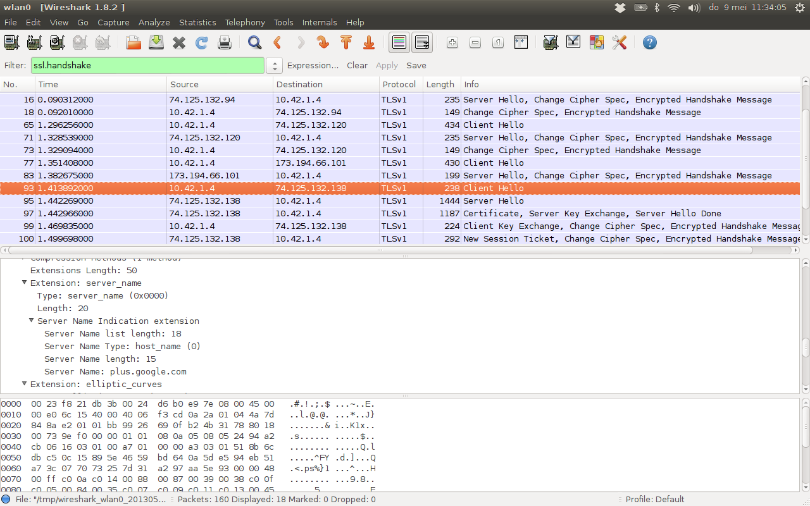

Slide 7


Introduction
Video traffic is “king of the hill”, dominating mobile networks [LCJC18]
Identifying video traffic challenging for mobile ISPs
Silhouette – detect video based on traffic “shape”
5-tuple flow
Transport layer statistics
Notes:
SNI, DPI

Slide 8
Outline
Introduction
Related Work
YouTube Video Streaming
Evaluation
Conclusions

Slide 9

YouTube Video Streaming
Most popular video provider over Verizon Wireless Network
20%+ traffic by volume from YouTube
12% overall traffic by volume delivered by Google’s QUIC
Streaming multiple video qualities [KBZ13]
Low quality: 240p, 360p, 480p
High quality: 720p, 1080p
YouTube supports streaming over two protocols
HTTP-based (with TCP): progressive downloading and HTTP adaptive streaming (HAS)
QUIC with UDP: similar to TCP + TLS + HTTP/2
→ Video player sends HTTP request for next video segment when playout buffer empty
Notes:
פרורגרסיבי – הכל באותה איכות, כל כמה שניות שולח בקשה למלא את הבאפר
האס – מוריד קטעים באורך של 2 עד 10 שניות. לכל וידאו יש מספר איכויות והלקוח "בוחר" מה להוריד כפונקציה של כל מיני משתנים כמו מהירות הורדה וכמה שניות נותר לנגן

Slide 10
YouTube Video Streaming Behavior
Downlink packets carry video segments
Large uplink packets carry “requests”
Small uplink packets may be application ACKs
YouTube Streaming with QUIC (Alpha Trailer)
First 20 seconds of Alpha trailer over QUIC, at 1080p, 24 f/s
Red “+” downlink packets, Blue “o” uplink packets
HTTPS/TCP based streaming appears similar
From manifest
YouTube URL uses REST API
URL is longer than 500 bytes
Notes:
כחול – בקשות, העלאה. יש בקשות גדולות מ500 בתים.
אדום – הורדה, מגיע בעקבות בקשות
יש לנו אי די יו (אפליקיישן דאטא יוניט) שמזוהות על ידי בקשות נשלחות הגדולות מגודל הסף שנקבע-500

Slide 11

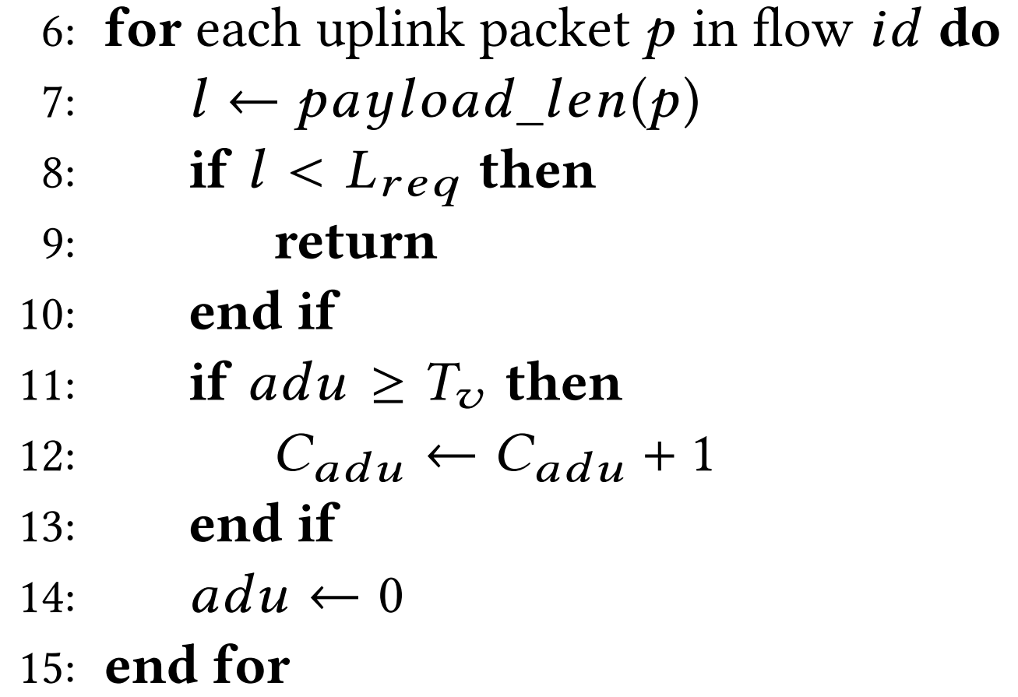
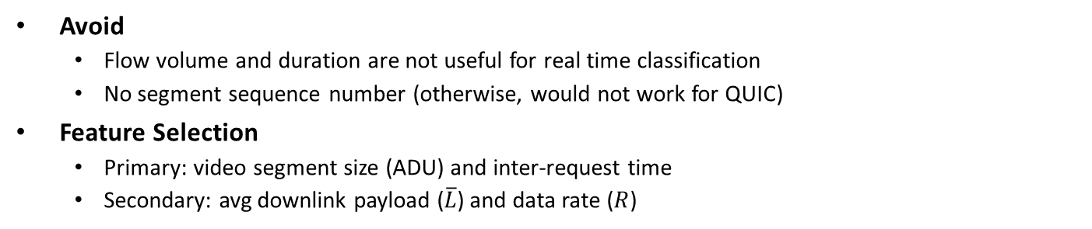
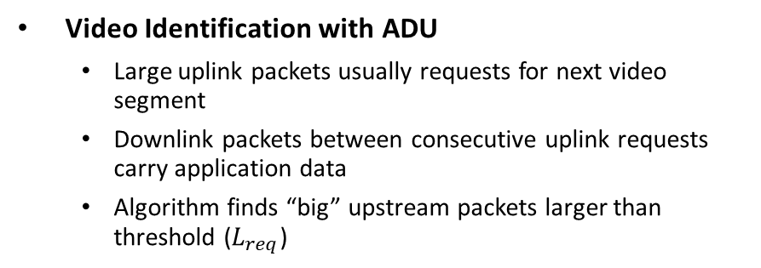
Silhouette – Video Flow Identification (1/2)
Avoid
Flow volume and duration are not useful for real time classification
No segment sequence number (otherwise, would not work for QUIC)
Feature Selection
Primary: video segment size (ADU) and inter-request time
Secondary: avg downlink payload ($\overline{L}$) and data rate ($R$)
Video Identification with ADU
Large uplink packets usually requests for next video segment
Downlink packets between consecutive uplink requests carry application data
Algorithm finds “big” upstream packets larger than threshold ($L_{req}$)
Video ADU Detection

Slide 12
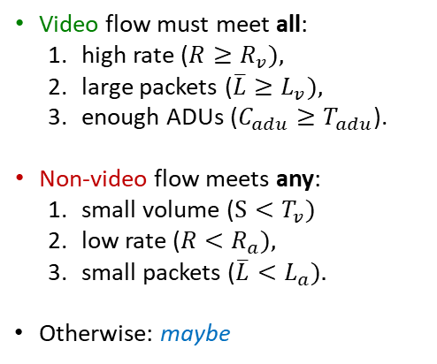
Silhouette – Video Flow Identification (2/2)
Based on flow stats, Silhouette decides if “video”, “non-video” or “maybe”.
Video flow must meet all:
high rate ($R≥R_{v}),$
large packets ($\overline{L}≥L_{v}),$
enough ADUs ($C_{adu}≥T_{adu}$).
Non-video flow meets any:
small volume ($S<T_{v})$
low rate ($R<R_{a}),$
small packets ($\overline{L}<L_{a}).$
Otherwise: maybe
Video Flow Identification

Slide 13
Silhouette Classification Example
Note:
Duration, volume, and SNIs listed for validation only – not use by Silhouette
For single video, YouTube opens 22 flows

Slide 14
Outline
Introduction
Related Work
YouTube Video Streaming
Evaluation
Conclusions

Slide 15



Ground Truth Collection
Setup Testbed
Dual Core Intel i5-4460 CPU, 32GB RAM
802.11 b/g/n wireless adapter and 150 Mb/s broadband
Linux 4.11.0-rc2 kernel
Chrome browser (v63.0.3239.84)
Stream video
Play all in YouTube Playlist: “2018 Movie Trailers”
Video qualities: 240p, 360p, 480p, 720p, and 1080p
Transport protocols: HTTPS/TCP and QUIC/UDP
Enable “stats for nerds” to record video server name and format id
Clear all history data and browser caching after every stream session

Slide 16
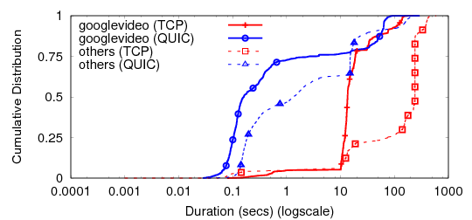
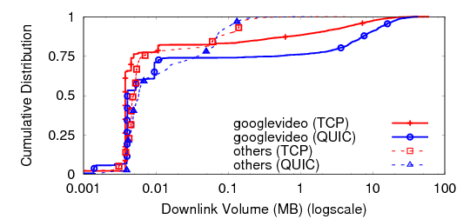
Flow Statistics in Ground Truth DataSet
Flow Duration
Flow Volume (downlink)
Server Name Indications (SNIs) reveal server’s role
SNIs matching with r*---sn*.googlevideo.com may carry video
Although only 660 video streaming sessions, 15,000+ flows
Not all SNI with r*---sn*.googlevideo.com carry video (e.g. less than 1 MB volume and short)

Slide 17
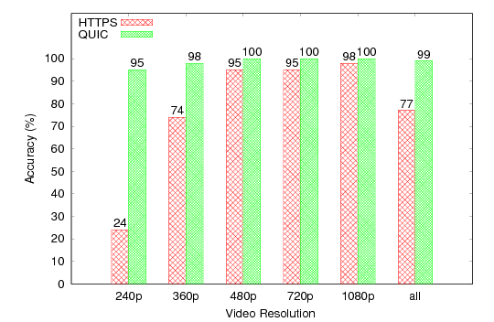
Silhouette Results
Without using SNIs, Silhouette near 90% accuracy
Higher for QUIC than HTTPS
Lower for low quality video (240p)
Most maybe since rate less than 192 kb/s
Silhouette Accuracy

Slide 18



Future Work
Evaluate with more video providers (e.g., Netflix, Amazon Video)
Implement Silhouette (e.g., as Linux TC classifier) on performance enhanced proxy
Consider Machine Learning (ML) enhancements to improve accuracy
Use for traffic shaping (e.g., utility function selection of PCC)

Slide 19



Conclusions
Silhouette - heuristic for video identification for YouTube Streaming
Classifies video flows based on “shape” in terms of data rates and payload lengths
Suitable for both HTTPS/TCP and QUIC/UDP streaming
Effective for encrypted video since does not use headers or SNIs
Light weight and suitable for ISP middle-boxes for traffic shaping
Silhouette available online
http://web.cs.wpi.edu/~claypool/papers/yt-crawler/

Slide 20
Questions?

Slide 21
References
[DLBP16] G. Dimopoulos, I. Leontiadis, P. Barlet-Ros, and K. Papagiannaki. 2016. “Measuring Video QoE from Encrypted Traffic”. In Proceedings of ACM SIGCOMM IMC. Santa Monica, CA, USA.
[KLC+16] A. Kakhki, F. Li, D. Chones, A. Mislove, and E. Katz-Bassett. 2016. “BingeOn Under the Microscope: Understanding T-Mobile’s Zero-Rating Implementation”. In Internet-QoE Workshop. Florianopolis, Brazil.
[KBZ13] D. Krishnappa, D. Bhat, and M. Zink. 2013. “DASHing YouTube: An Analysis of Using DASH in YouTube Video Service”. In Proceedings of LCN.
[LCK15] F. Li, M. Claypool, and R. Kinicki. 2015. “Treatment-based Traffic Classification for Residential Wireless Networks”. In International Conference on Computing, Networking and Communications (ICNC). Anaheim, CA.
[LMR+17] F. Li, A. Razaghpanah, K. Molavi, N. Akhavan, D. Chones, P. Gill, and A. Mislove. 2017. “liberate,(n): A Library for Exposing Traffic-Classification Rules and Avoiding them Efficiently”. In Proceedings of the Internet Measurement Conference.
[KHD13] J. Khalife, A. Hajjard, and J. Diaz-Verdejo. 2013. “Performance of OpenDPI in Identifying Sampled Network Trafic “ Journal of Networks 8, 1 (2013), 71–81.
[NABZ12] T.T.T. Nguyen, G. Armitage, P. Branch, and S. Zander. 2012. “Timely and Continuous Machine-learning-based Classification for Interactive IP Tracffic.” IEEE/ACM Transactions on Networking (TON) 20, 6 (2012), 1880–1894.
[NG08] T. T. T. Nguyen and G. Armitage. 2008. “A Survey of Techniques for Internet Traffic Classification Using Machine Learning”. IEEE Communications Surveys Tutorials 10, 4 (April 2008).
[RK17] A. Reed and M. Kranch. 2017. “Identifying HTTPS-Protected Netflix Videos in Real-Time”. In Proceedings of CODASPY. Scottsdale, AZ, USA.
[ZCX+13] J. Zhang, C. Chen, Y. Xiang, W. Zhou, and Y. Xiang. 2013. “Internet Traffic Classification by Aggregating Correlated Naive Bayes Predictions.” Journal of IEEE Transactions on Information Forensics and Security 8, 1 (January 2013), 5–15

Slide 22
Thank You

